Slide 1








Avatars scenario library Inside the home
DECEMBER 2021

Slide 2
































House plants

Slide 3












House plants

Slide 4
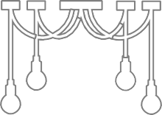
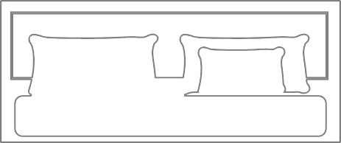
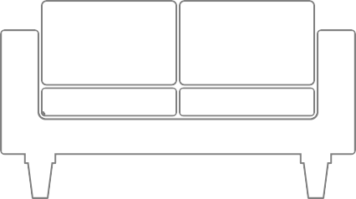

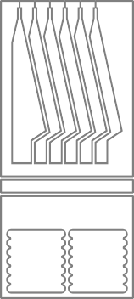
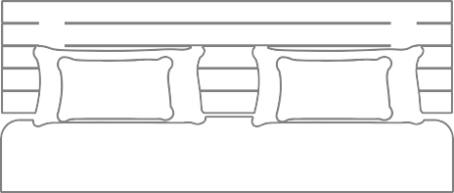
Simple outlined furniture

Slide 5

















Furniture - Various

Slide 6













Furniture - Various

Slide 7


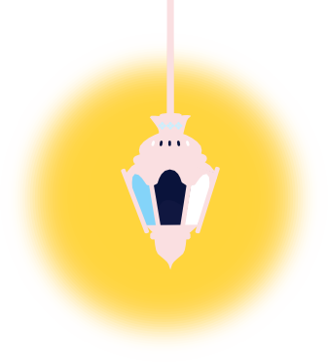













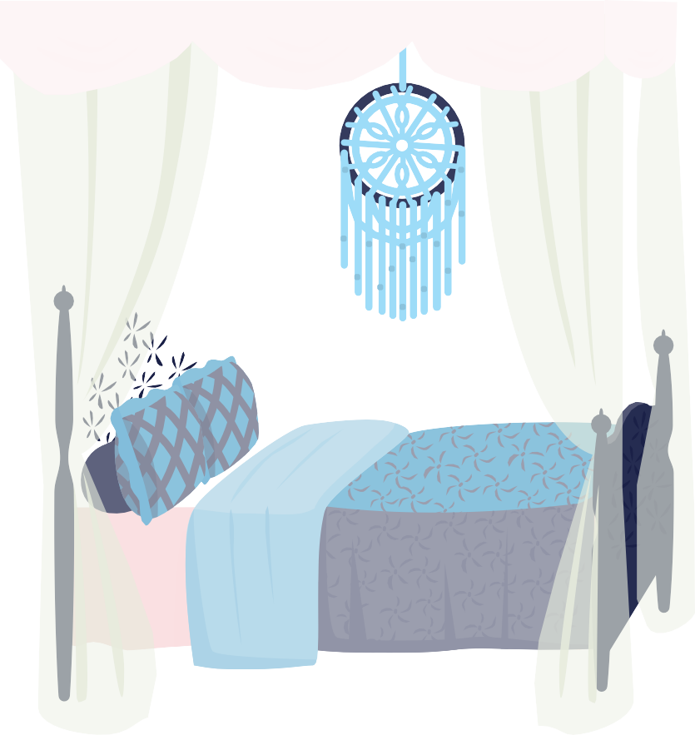











Eastern furniture

Slide 8


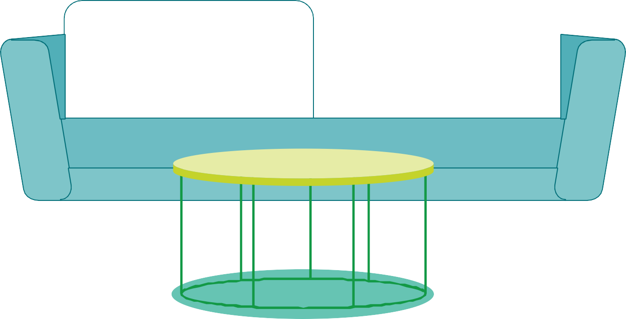
Example background scene

Slide 9
Example background scene

Slide 10

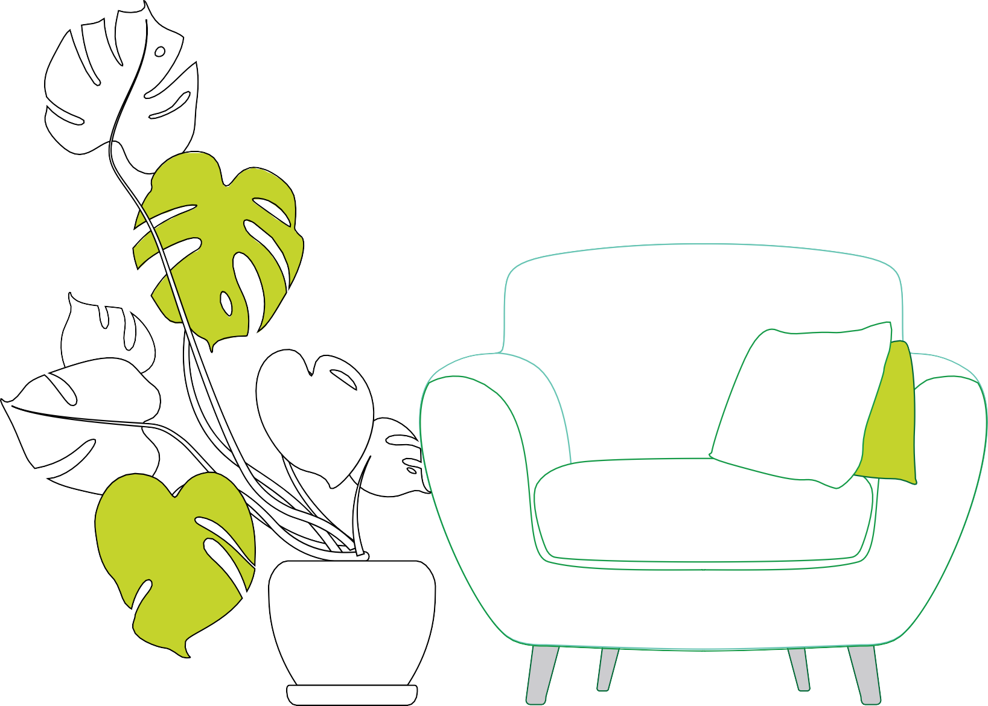


Example background scene

Slide 11



ETexaxtmupreles background scene

Slide 12


Example background scene

Slide 13
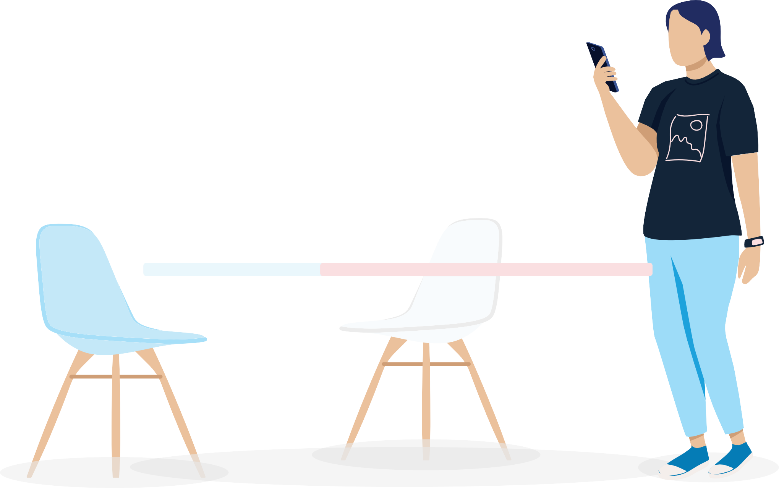
Example background scene

Slide 14








Example background scenes

Slide 15

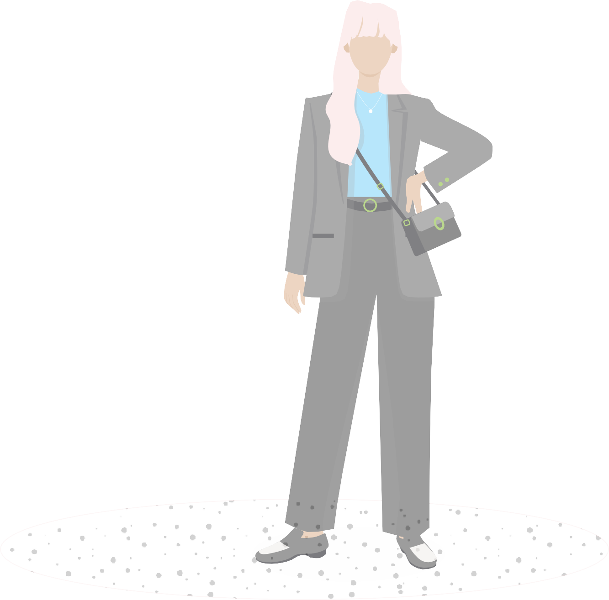


Example background scene

Slide 16




Example background scene

Slide 17

Deloitte refers to one or more of Deloitte Touche Tohmatsu Limited
(collectively, the “Deloitte organization”). DTTL (also referred to as “Deloitte separate and independent entities, which cannot obligate or bind each related entity is liable only for its own acts and omissions, and not those
of each other. DTTL does not provide services to clients. Please see www. deloitte.com/about to learn more.
© 2021. For information, contact Deloitte Touche Tohmatsu Limited.

